Slide 1

Case based scenarios by identifying entities and relationships TEchnical presentation
Presnted by :
V.Shalini

Slide 2
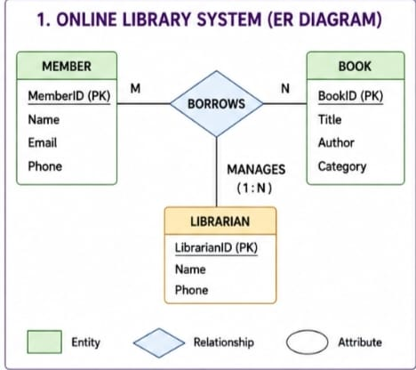
1. Create and present an er diagram for an online library system, explaining each component clearly
Online Library System :
Stores book information.
Keeps member records.
Records book issue and return.
Managed by librarians.
Uses an ER diagram for database design.

Slide 3
ER DIAGRAM COMPONENTS
Entities Primary Key
Book Book ID
Member Member ID
Librarian
Borrow Record
Attributes Relationships
Book ID Member borrows Book
Member ID Librarian manages Books
Book Title

Slide 4
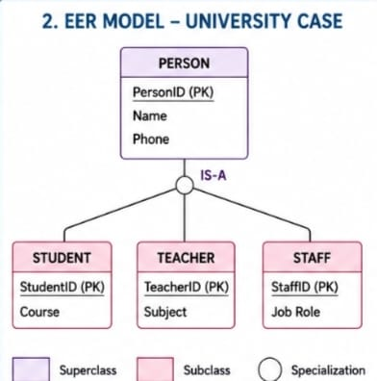
2.Prepare a presentation on the eer model, demonstrating generalization and specialization with a university case
Enhanced ER (EER) Model
Advanced version of ER model.
Represents detailed data.
Supports inheritance.
Organizes related entities.
Improves database design.

Slide 5
GENERALIZATION AND SPECIALIZATION
Specialization
Divides one entity into smaller groups.
Person → Student, Teacher, Staff.
Each group has unique details.
Generalization
Combines similar entities.
Creates one common superclass.
Reduces repeated data.
Makes the database simple.

Slide 6
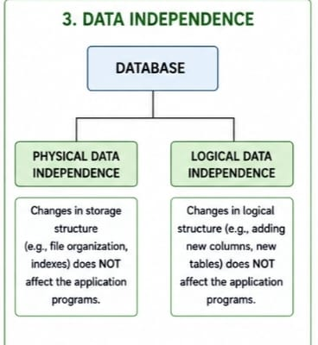
3.Present the concept of data independence (logical and physical) and its significance in dbms architecture
Introduction
Data can change without affecting users.
Improves database flexibility.
Simplifies maintenance.
Supports future changes.
Reduces application updates.

Slide 7
TYPES OF DATA INDEPENDENCE
Physical Data Independence
Changes storage methods.
Changes file organization.
User programs remain the same.
Improves storage performance.
Logical Data Independence
Changes table structure.
Adds new columns.
Applications continue working.
Makes database updates easier.

Slide 8
IMPORTANCE OF DATA INDEPENDENCE
Saves development time.
Easy database maintenance.
Improves performance.
Supports system growth.
Protects user applications.

Slide 9
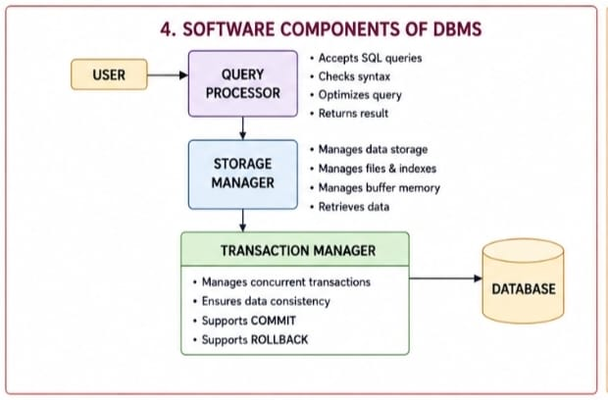
4. Deliver a technical presentation on the software components of a dbms, explaining query processor , storage manager, and transaction manager.
Introduction
DBMS manages database operations.
Works with different software components.
Stores and retrieves data.
Processes user requests.
Ensures reliable database performance.

Slide 10
Query Processor
Reads SQL queries.
Checks query errors.
Finds the best execution method.
Returns requested data.
Transaction Manager
Handles multiple users.
Maintains data accuracy.
Supports Commit.
Supports Rollback.
Prevents data loss.
Storage Manager
Stores database files.
Organizes data.
Manages memory.
Retrieves stored information.

Slide 11
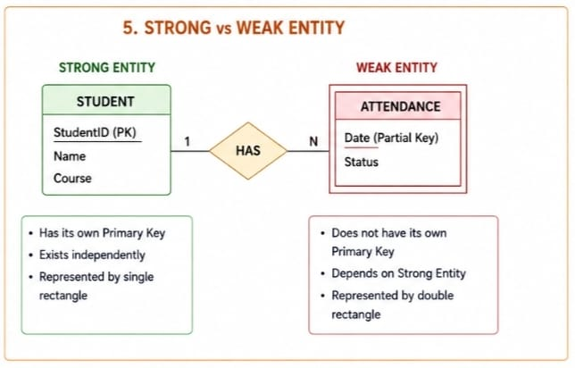
5.Prepare a presentation comparing strong and weak entities in er modelling with real-word examples
Introduction
Entities represent real objects.
Used in database design.
Can be strong or weak.
Helps organize information.
Shows relationships between data.

Slide 12
Strong Entity
Features
Has its own primary key.
Exists independently.
Easily identified.
Uses a single rectangle.
Examples
Student
Employee
Product
Customer

Slide 13
WEAK ENTITY
Features
Depends on a strong entity.
Has a partial key.
Cannot exist alone.
Uses a double rectangle.
Examples
Order Item
Library Fine
Employee Dependent
Student Attendance

